Slide 1
Machine Learning
By
Jiten sahoo

Slide 2
What is Machine Learning
Machine learning is a branch of artificial intelligence (AI) and computer science which focuses on the use of data and algorithms to imitate the way that humans learn, gradually improving its accuracy.

Slide 3


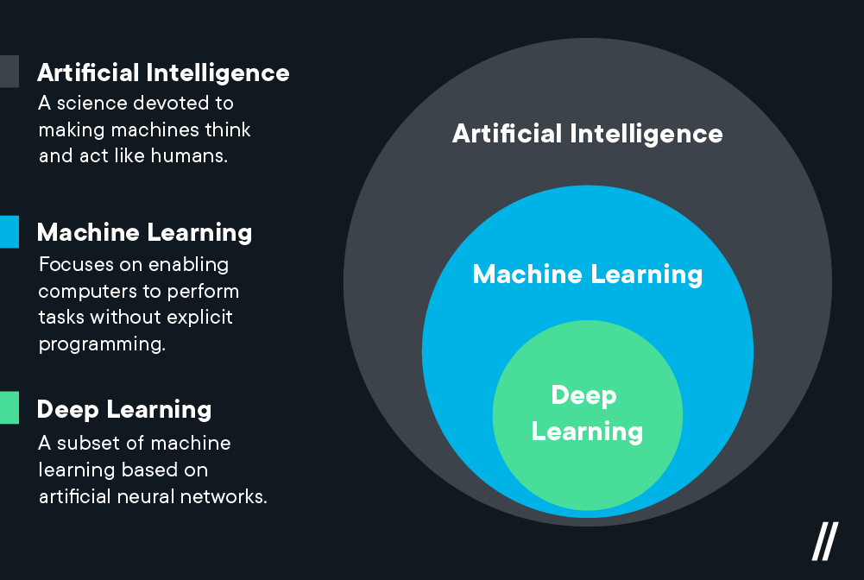




Slide 4
Machine Learning Steps
1.Collecting Data
2.Preparing Data
3.Choosing a Model
4.Training a Model
5.Evaluating Model
6.Hyperparameter tuning
7.Make Prediction

Slide 5
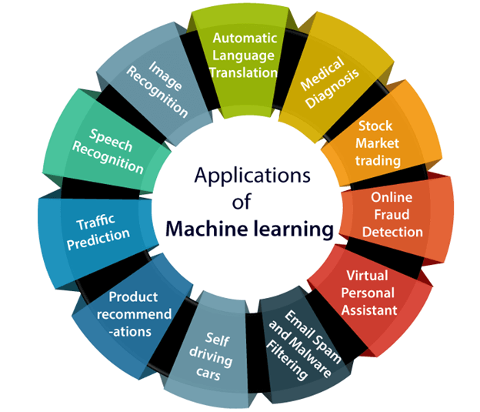
Application of Machine Learning

Slide 6

Types of Machine Learning
Supervised Machine Learning
Unsupervised
Semi-Supervised
Reinforcement

Slide 7
Supervised ML
Regression: Output is numeric
Classification : Output is a class

Slide 8

Regression Examples
House price prediction
Flight Fare prediction
Loan eligible Amount prediction

Slide 9

Classification Problem
Spam Filtering
Customer behavior prediction
Document Classification
Loan eligibility prediction

Slide 10
Unsupervised Machine Learning
Clustering : Splitting the dataset into groups based on similarity.
Association mining: Identifying sets of items in a data set that frequently occur together.

Slide 11
Semi Supervised Machine Learning
Combination of Supervised and un supervised ML.

Slide 12
Reinforcement learning
Reinforcement learning is all about making decisions sequentially. The output depends on the state of the current input and the next input depends on the output of the previous input.
Reinforcement Learning is a feedback-based Machine learning technique in which an agent learns to behave in an environment by performing the actions and seeing the results of actions. For each good action, the agent gets positive feedback, and for each bad action, the agent gets negative feedback or penalty.

Slide 13
Train Test Split
Splitting data into training and testing dataset.
Training data will be used to train a model.
Testing data will be used to check model performance.

Slide 14
Validation Techniques
Cross Validation
K fold Cross validation
Stratified K-Fold Cross-Validation
OOB
Out of bag score
OOB_Score is a very powerful Validation Technique used especially for the Random Forest algorithm for least Variance results.

Slide 15
Hyperparameter Tuning
A hyperparameter is a parameter whose value is set before the learning process begins.
The parameters for which the Model performs best or model has best parameters.
We can Use either GridsearchCV or RandomizedsearchCV for Hyperparameter Tuning.
https://towardsdatascience.com/hyperparameter-tuning-c5619e7e6624

Slide 16
Different types of metrics for Classification
Confusion Matrix
Precision
Recall
F1 score
Accuracy
AUC-ROC score
https://towardsdatascience.com/understanding-confusion-matrix-a9ad42dcfd62

Slide 17

Metrics for Regression
Mean Squared Error
Mean Absolute Error
RMSE
R2 score
Adjusted R2 score

Slide 18
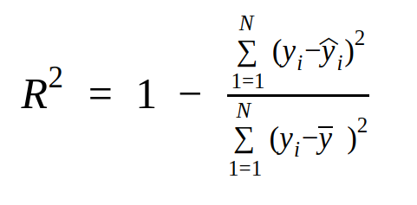
R2 score

Slide 19

Curse of dimensionality
It really refers to is when your data has too many features.
If we have more features than observations than we run the risk of massively overfitting our model. this would generally result in terrible out of sample performance.

Slide 20
Feature Selection
It is a process of automatically or manually selecting the subset of most appropriate and relevant features to be used in model building.

Slide 21
Methods for Feature selection
A. Filter methods
B. Wrapper methods
C. Embedded methods
D. Hybrid methods

Slide 22
Benefits of Feature selection
It helps in avoiding the curse of dimensionality.
It helps in the simplification of the model so that it can be easily interpreted by the researchers.
It reduces the training time.
It reduces overfitting hence enhance the generalization.

Slide 23

Filter Methods
Filter methods pick up the intrinsic properties of the features measured via univariate statistics instead of cross-validation performance.
These methods are faster and less computationally expensive than wrapper methods. When dealing with high-dimensional data, it is computationally cheaper to use filter methods.

Slide 24

Ways of Filter Methods
Information Gain (Mutual_info_classif/Mutual_info_reg)
Correlation coefficient
Chi square test
Fisher's score

Slide 25

Information Gain
Information gain calculates the reduction in entropy from the transformation of a dataset.
It uses mutual_info_score for both regression and classification to find the best features.

Slide 26

Correlation Coefficient
Correlation is a measure of the linear relationship of 2 or more variables. Through correlation, we can predict one variable from the other.
The logic behind using correlation for feature selection is that the good variables are highly correlated with the target.
sns.heatmap(Df.corr(),annot=True)

Slide 27

Chi square Test
The Chi-square test is used for categorical features selection in a dataset.

Slide 28

Imbalanced Dataset
A classification data set with skewed class proportions is called imbalanced. Classes that make up a large proportion of the data set are called majority classes. Those that make up a smaller proportion are minority classes.

Slide 29
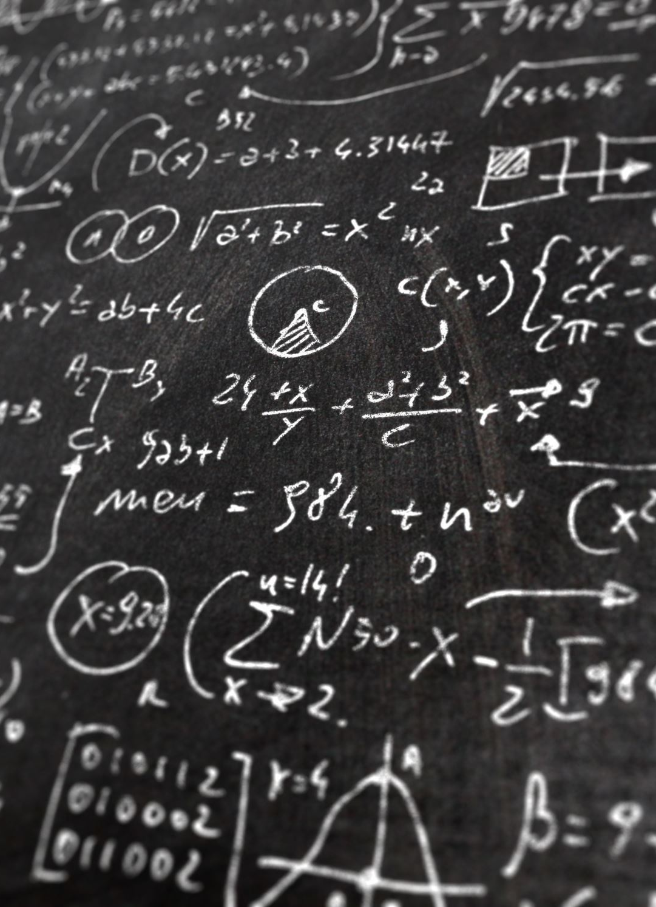
Effect of Imbalanced Dataset
An imbalanced dataset is defined by great differences in the distribution of the classes in the dataset.
This means that a dataset is biased towards a class in the dataset. If the dataset is biased towards one class, an algorithm trained on the same data will be biased towards the same class.

Slide 30
How to detect Imbalanced Dataset
Using count Plot.
Using value_counts()

Slide 31
How to handle it?
Downsampling and Upweighting
Using Metrics (precision and Recall & Auc-ROc score)
Smote technique

Slide 32
Bias and Variance Tradeoff
The bias is known as the difference between the prediction of the values by the ML model and the correct value. Being high in biasing gives a large error in training as well as testing data. Its recommended that an algorithm should always be low biased to avoid the problem of underfitting. By high bias, the data predicted is in a straight line format, thus not fitting accurately in the data in the data set. Such fitting is known as Underfitting of Data.

Slide 33
If the algorithm is too simple (hypothesis with linear eq.) then it may be on high bias and low variance condition and thus is error-prone. If algorithms fit too complex ( hypothesis with high degree eq.) then it may be on high variance and low bias. In the latter condition, the new entries will not perform well. Well, there is something between both of these conditions, known as Trade-off or Bias Variance Trade-off.

Slide 34
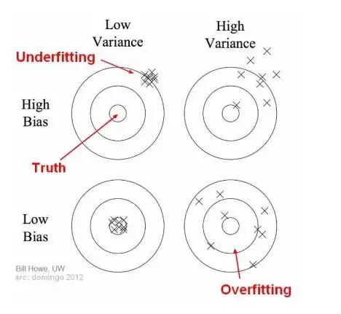
Pictorial Representation

